Slide 1
Lead Score Case Study
Students –
Venugopalan MR
Vaasanthi Polu
Dipali Gurnule

Slide 2
Business Understanding
An education company named X Education sells online courses to industry professionals.
People land on the website through different sources, sometimes reference and fill in the form. Once the form is filled they are converted to lead.The typical lead conversion rate at X education is around 30%.
Although X Education gets a lot of leads, its lead conversion rate is very poor. For example, if, say, they acquire 100 leads in a day, only about 30 of them are converted.
To make this process more efficient, the company wishes to identify the most potential leads, also known as ‘Hot Leads’, as the sales team will now be focusing more on communicating with the potential leads rather than making calls to everyone.

Slide 3
Business Objective
To select the leads that are most likely to convert into paying customers.
The company requires a model wherein a lead score is assigned to each of the leads such that the customers with a higher lead score have a higher conversion chance and the customers with a lower lead score have a lower conversion chance.
A ballpark of the target lead conversion rate to be around 80%.

Slide 4
Solution Process -
Data Cleaning and Manipulation –
1. Check and handle duplicate data, NA Values and Missing Values
Drop columns, if it contains large amount of missing values and not useful for the analysis.
Imputation of the values, if necessary
Check and handle outliers in data.
EDA –
Univariate data analysis: value count, distribution of variable
Bivariate data analysis: correlation coefficients and pattern between the variables
Feature Scaling & Dummy Variables and encoding of the data.
Classification technique: logistic regression used for the model making and prediction
Validation of the model
Model presentation
Conclusions and recommendations.

Slide 5
Data Manipulation
There is a value select in few features which is almost equal to null, change all the select values to ‘np.nan’
Drop ‘Prospect ID’, ‘lead number’ columns as they are index columns
Single value features like 'I agree to pay the amount through cheque’, 'Magazine', 'Receive More Updates About Our Courses’, ‘ Update me on Supply Chain Content', 'Get updates on DM Content‘ are dropped as they show no variance on the data.
Dropping columns with no variance after univariate analysis 'Do Not Call', 'Search', 'Newspaper Article',‘ X Education Forums', 'Newspaper', 'Digital Advertisement', ‘Through Recommendations‘ , 'Country',‘ What matters most to you in choosing a course'
Dropping the columns having more than 35% as missing value such as How did you hear about X Education and Lead Profile.

Slide 6
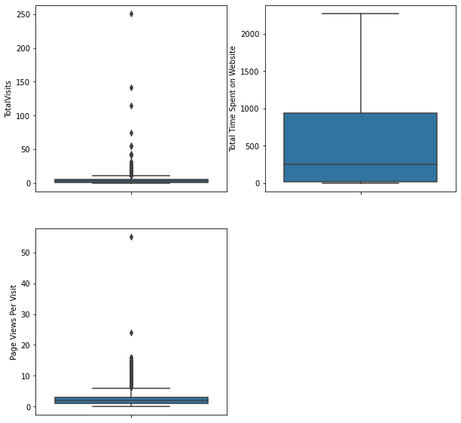
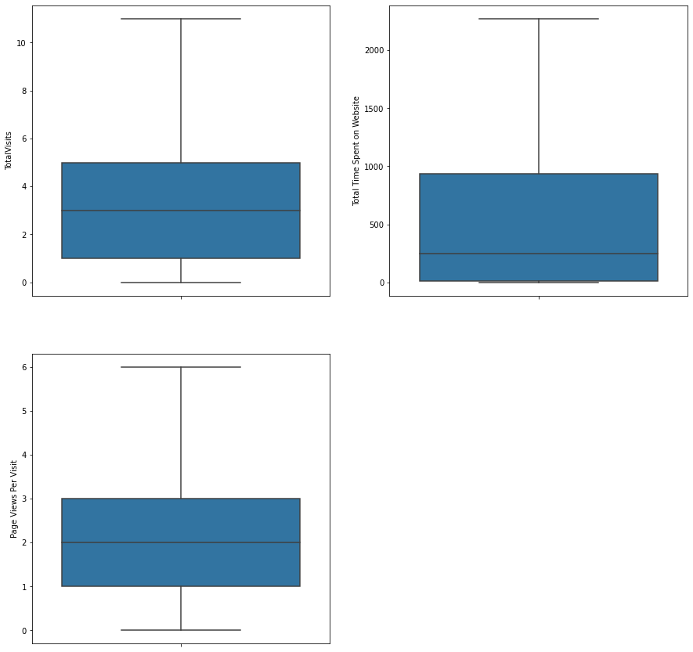
Outliers are identified and handled using capping .

Slide 7
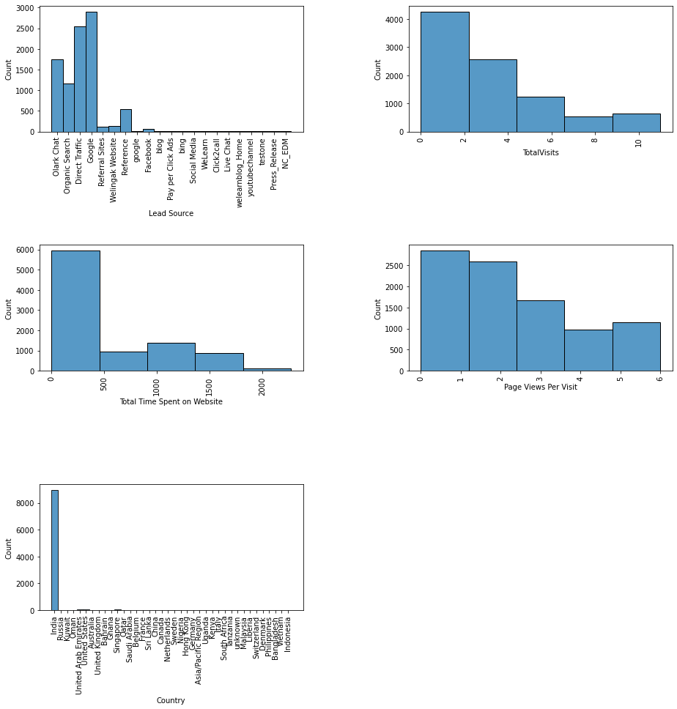
Univariate Analysis
Using histplot for numerical varaibles:
We see the lead source is mostly from google
Only India has more leads
Total visits are graddually decreasing

Slide 8
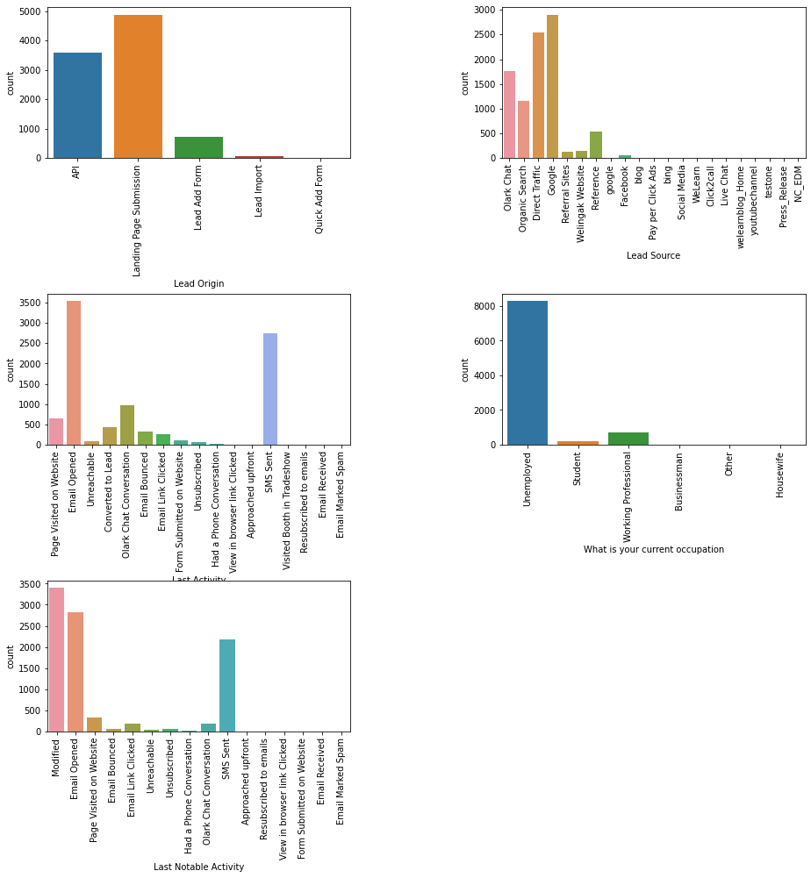
Using Countplot for categorical variables
Unemployed preferred to chose the company more
lead source is more from google followed by direct traffic

Slide 9
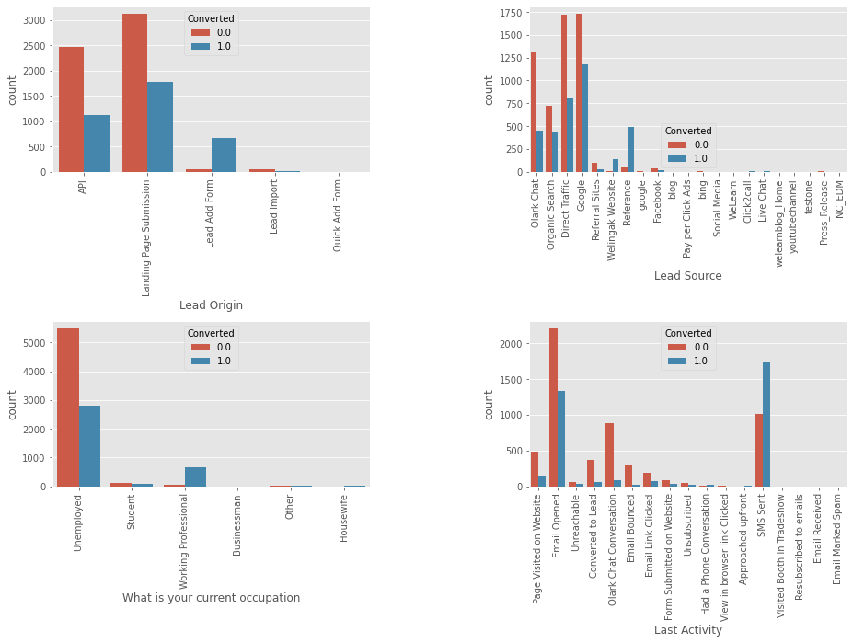
Bivariate Analysis
People who landed on page submission are converted
people from lead source as google are considered for conversion
Working professionals are considered for conversion
People who receive an sms are considered for conversion

Slide 10
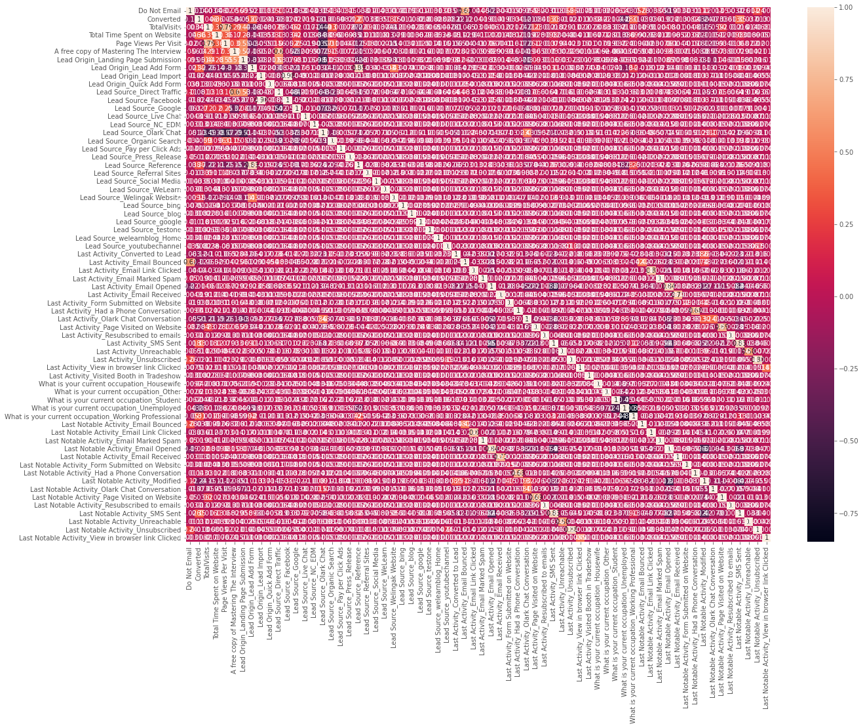
Data Preparation
Binary Variables are mapped.
Categorical Variables with multiple levels are one-hot encoded(dummy variables are created)
Highly Correlated dummy varibles are dropped

Slide 11
Model Building
Train-Test split
Splitting the dataset in 70,30 ratio for train,test
Using StandardScaler for scaling the numerical variables.
Using logistic regression() for building the model
Using RFE algorithm for feature selection using 20 variables as output
Using GLM to fit the model
Eliminating the insignificant variables whose p value is greater than 0.05 and VIF value greater than 5

Slide 12
The final model obtained is:
Out[83]:
 | Feature | VIF
0 | Do Not Email | 1.806070
1 | Total Time Spent on Website | 1.203181
2 | Lead Origin_Lead Add Form | 1.420101
3 | Lead Source_Olark Chat | 1.668478
4 | Lead Source_Welingak Website | 1.234910
5 | Last Activity_Converted to Lead | 1.240665
6 | Last Activity_Email Bounced | 1.794549
7 | Last Activity_Olark Chat Conversation | 1.988498
8 | What is your current occupation_Working Profes... | 1.136381
9 | Last Notable Activity_Email Link Clicked | 1.018204
10 | Last Notable Activity_Email Opened | 1.103369
11 | Last Notable Activity_Had a Phone Conversation | 1.001363
12 | Last Notable Activity_Modified | 1.915776
13 | Last Notable Activity_Olark Chat Conversation | 1.322950
14 | Last Notable Activity_Page Visited on Website | 1.024364

Slide 13
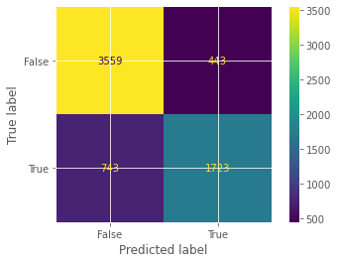

Evaluating the model
Using confusion matrix on train data to find accuracy, specificity, sensitivity
Using confusion matrix on test data to find accuracy, specificity, sensitivity
Train set:
accuracy=81.6%
sensitivity=69.9%
specificity=88.9%
Test set:
accuracy=81.7%
sensitivity=73.8%
specificity=86.4%

Slide 14
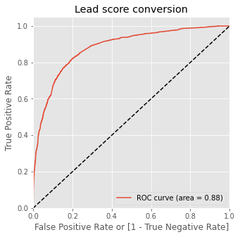
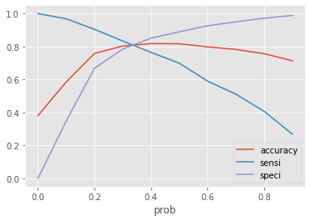
ROC Curve
It shows the tradeoff between sensitivity and specificity
Optimal cutoff probability is that probability where we get balanced sensitivity and specificity
From the curve 0.3 is the optimum point to take it as a cutoff probability.

Slide 15
Conclusion
It was found that the variables that mattered the most in the potential buyers are (In descending order)
Lead Origin_Lead Add Form
What is your current occupation_Working Professional
Last Notable Activity_Had a Phone Conversation
Lead Source
Welingak Website
Olark Chat
Total Time Spent on Website
The Model has achieved 80% accuracy required by the company.
The top leads are listed which can be contacted are more than 100

